Slide 1
URLs:
FAST API URL Link: FastAPI - Swagger UI
Docker link: Image Layer Details - saik1994/fapi-lr:v1 | Docker Hub
Checking FAST API link generated by docker in local, Link : FastAPI - Swagger UI
Webview Link: webview
Git hub link for fastapi - Saikeerthanakumar/hacathon_fastapi
Git hub Link : Saikeerthanakumar/stmlit-test
Deploying docker image, git hub – fast api, git hub Streamlit in GCP,
Link: Metrics – …mlit-test – Services – Cloud Run – My First Project – Google Cloud console
Streamlit gcp: https://stmlit-test-902968606805.us-central1.run.app
Docker gcp: https://hacathon-fastapi-902968606805.us-central1.run.app

Slide 2
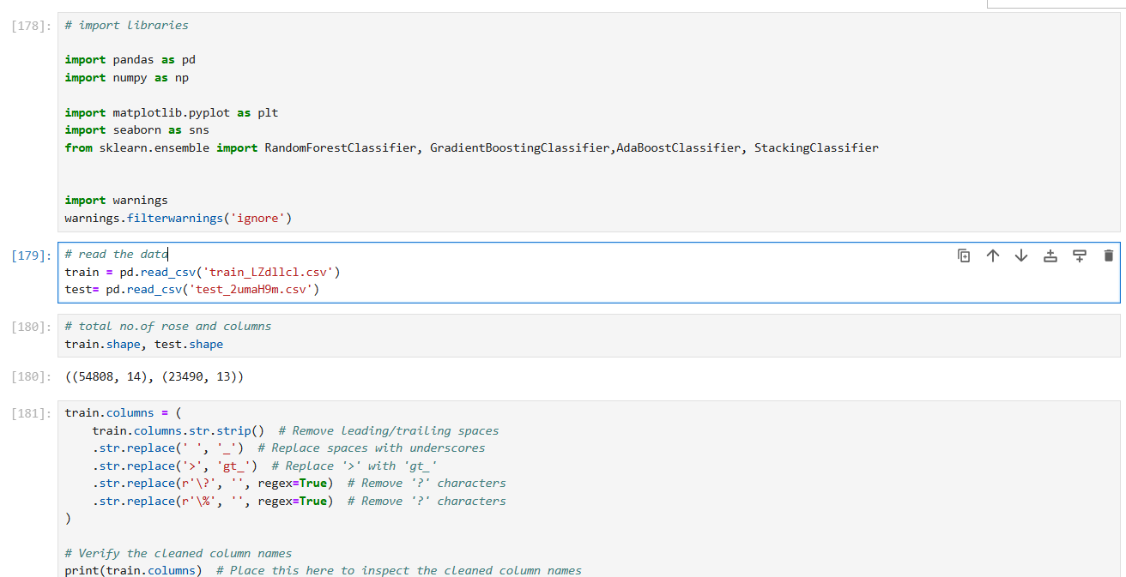
Analyzing Promotion Prediction Data
Step 1 : Extract and Analyse the train and test data and removing the special characters from the data set

Slide 3
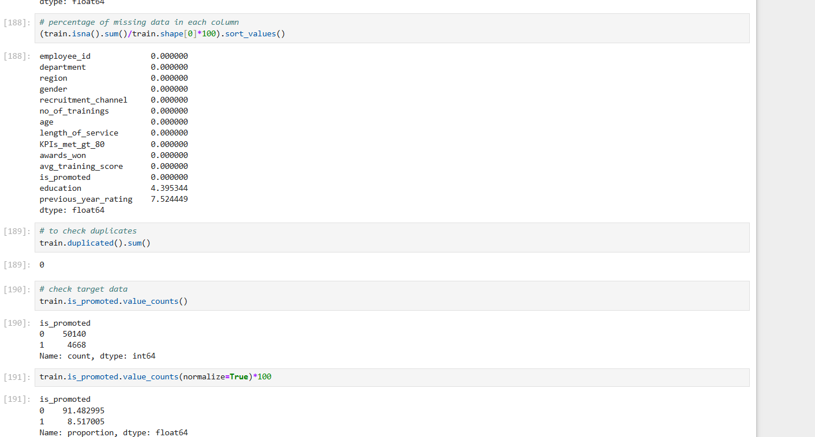
Step 2: Checking the NA, missing values, unique values, duplicates along with their percentage

Slide 4
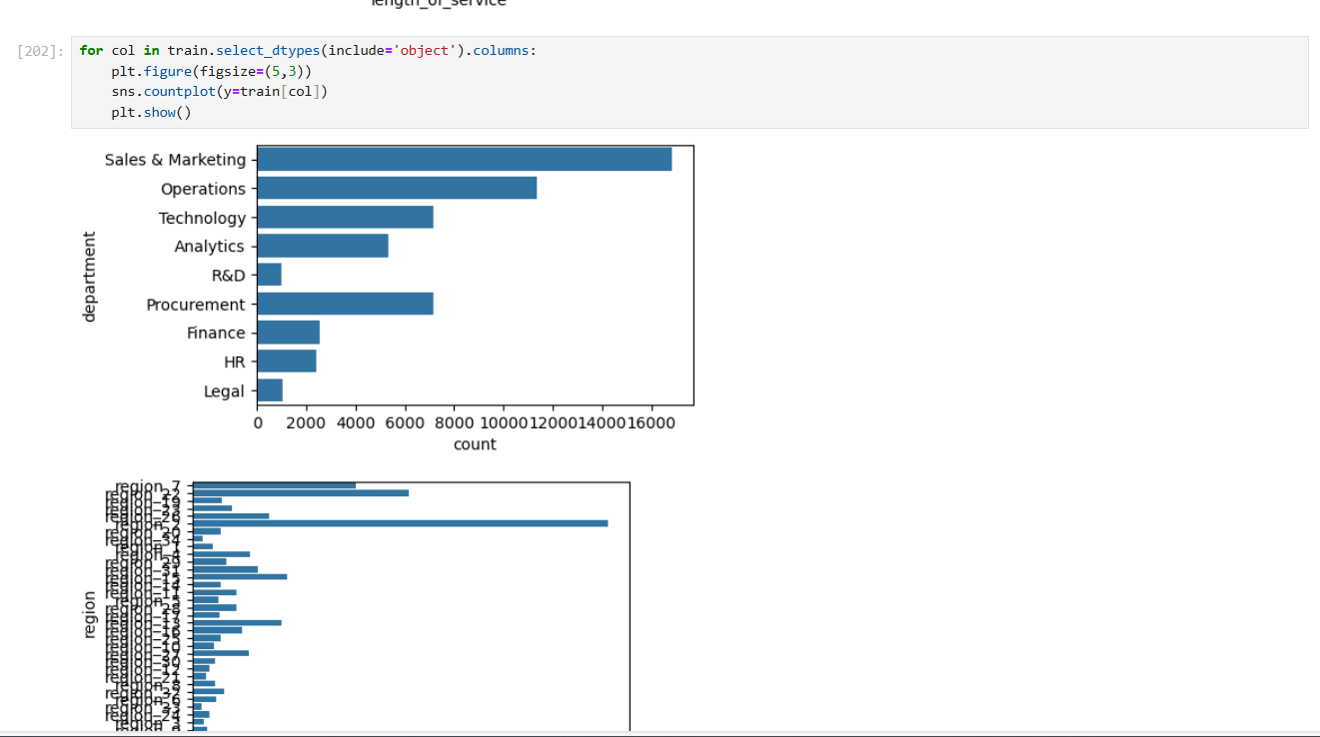
Step 3: Plotting and find the differences, ignoring the unique value column –(employee-id),getting the count of unique value

Slide 5
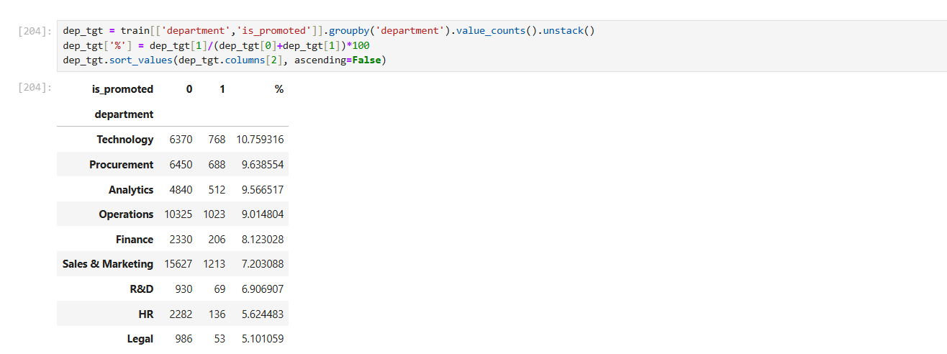

Slide 6
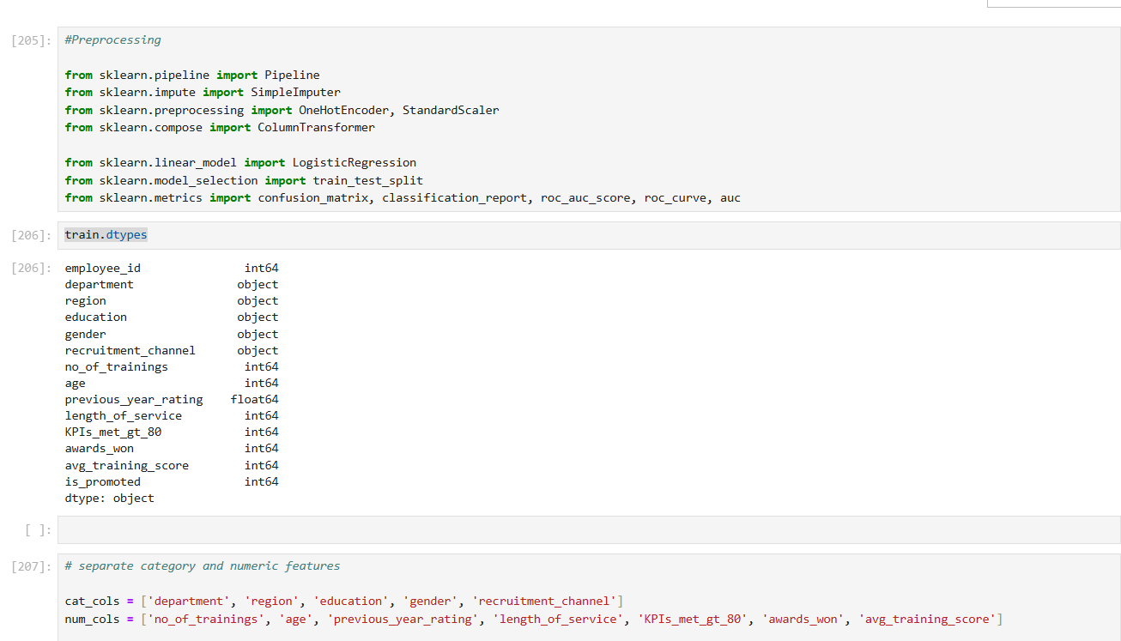
Preprocessing – importing the required libraries and creating a preprocess model with categorical and numerical encoding

Slide 7
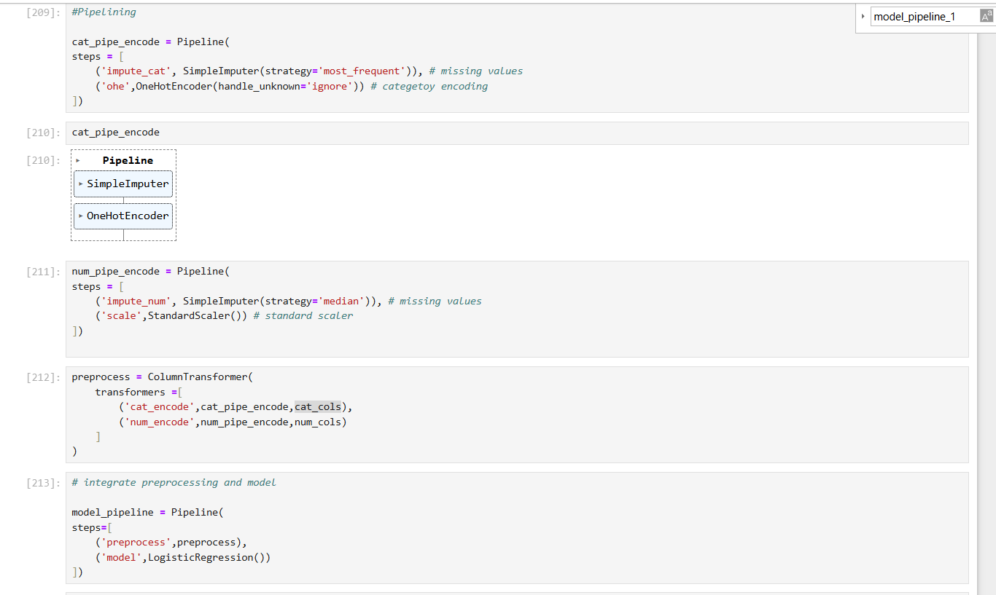
Creating a pipeline models

Slide 8
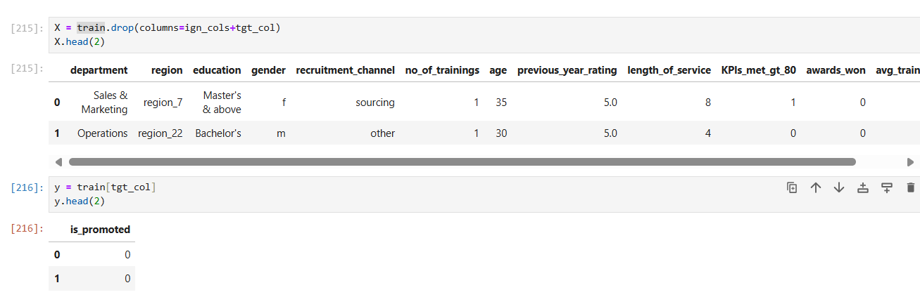
Getting X and y values

Slide 9
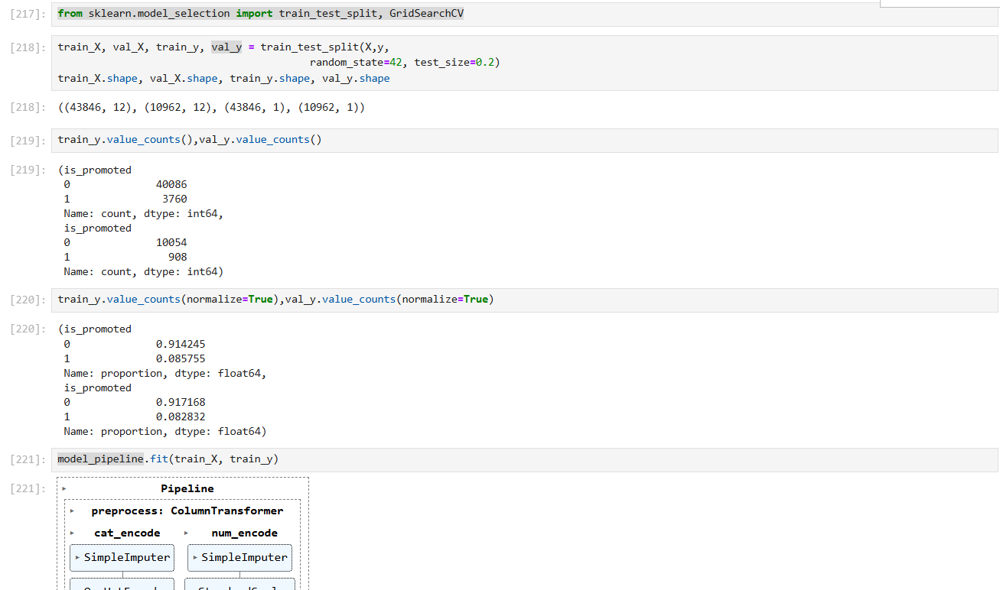
Creating train test split and applying Grid search CV

Slide 10
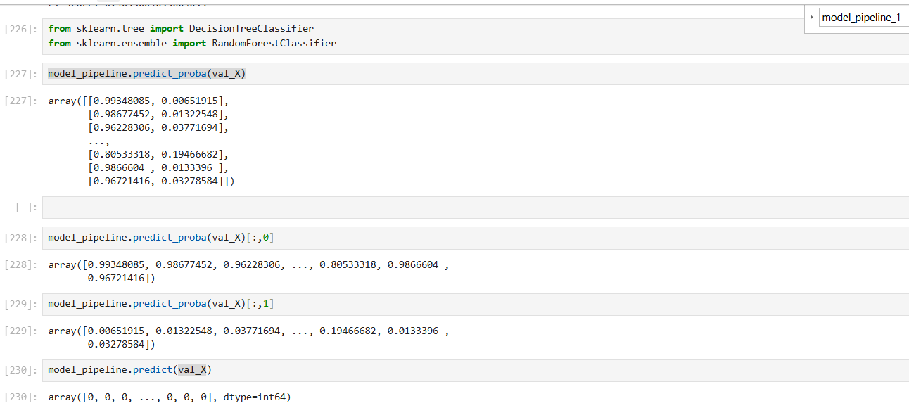
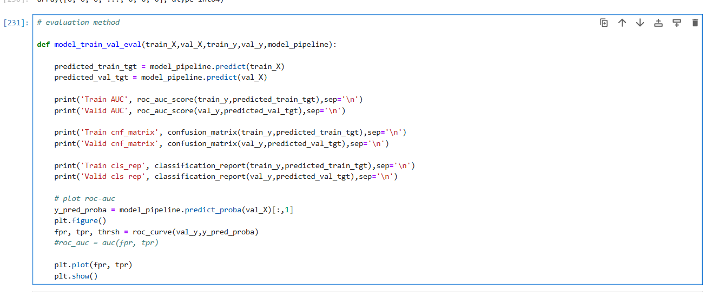
Predicting the probability and creating a evaluation model method

Slide 11
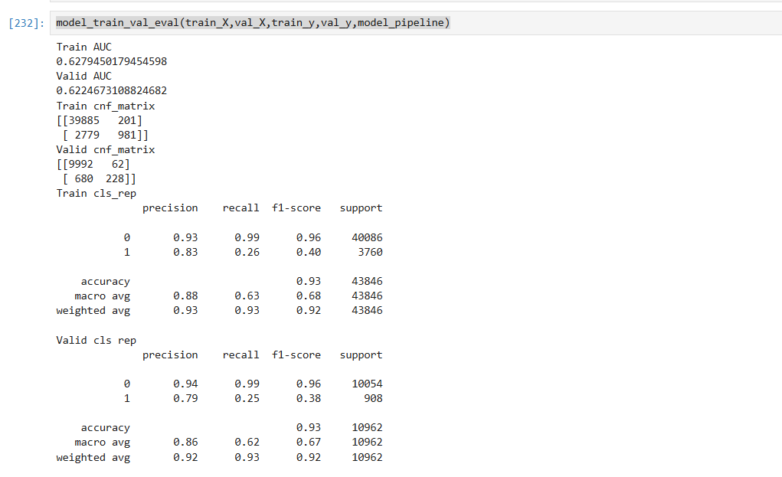
Model pipeline -1 – Logistic regression result score

Slide 12
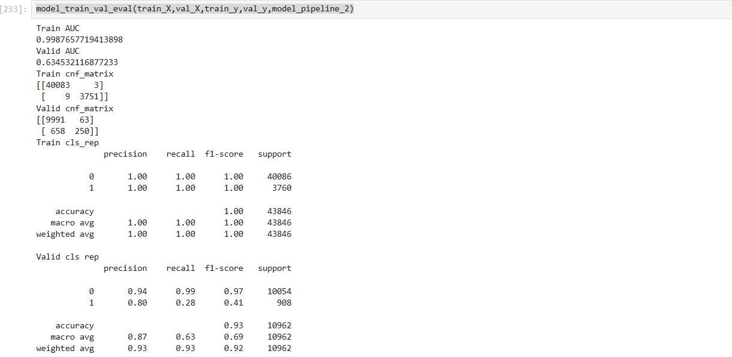
Created another model pipeline using Random Forest to increase the F1 score
model_pipeline_2 = Pipeline( steps=[ ('preprocess', preprocess), ('classifier', RandomForestClassifier()) ])model_pipeline_2.fit(train_X, train_y)y_pred_random = model_pipeline_2.predict(val_X)

Slide 13
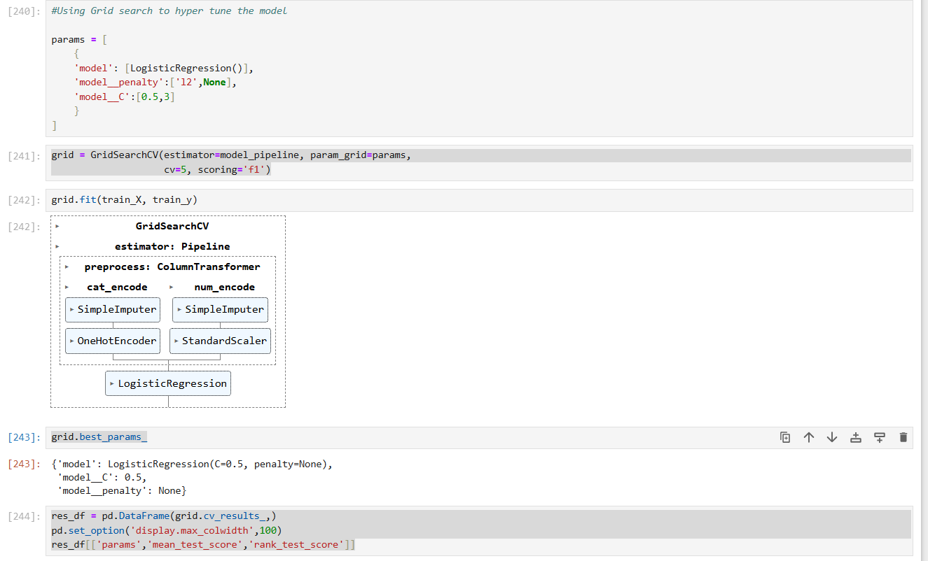
Using Param Grid search to hyper tune the model

Slide 14
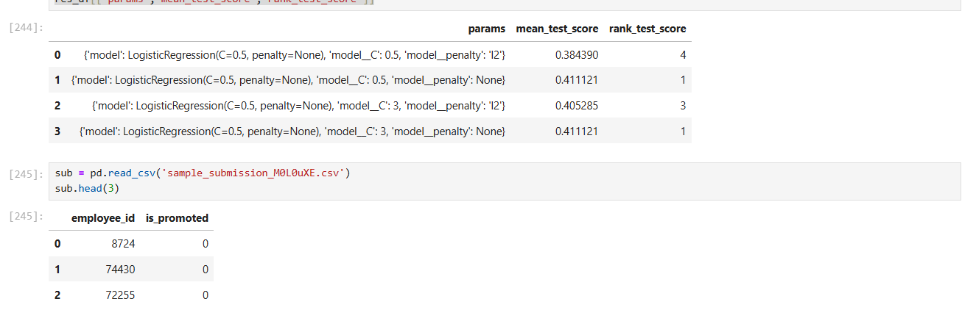
Created a sample csv submission file – First submission to check score and rank in analytics vidya

Slide 15
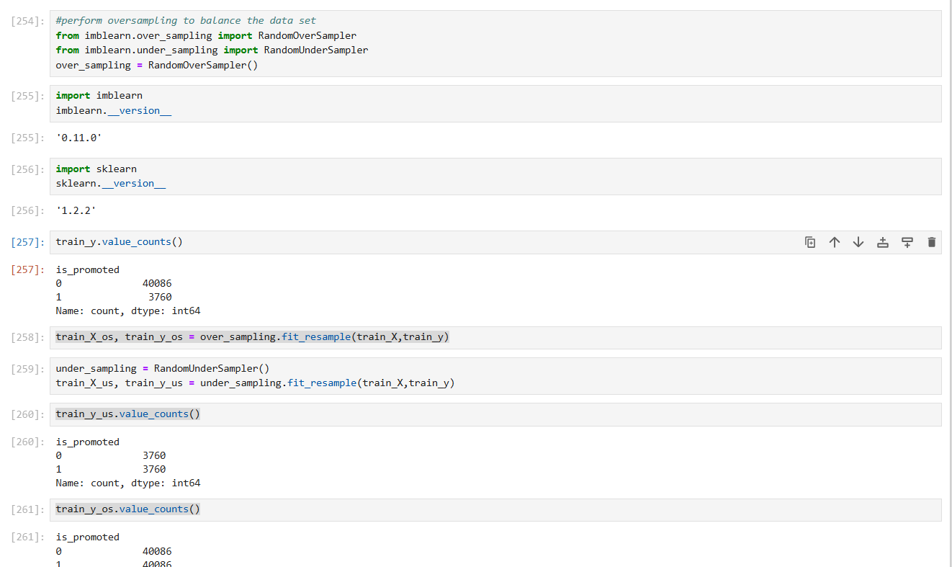
Imported libraries to perform oversampling and undersampling

Slide 16
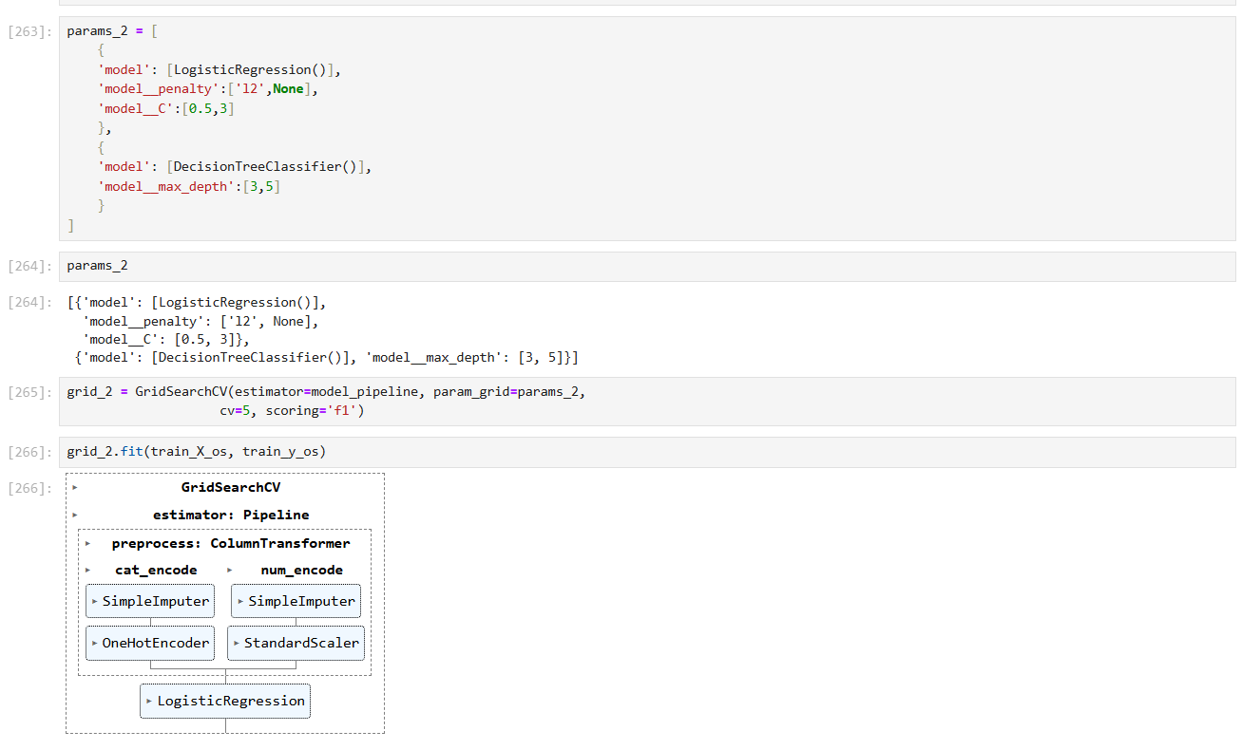
Created param grid with Logistic regression and Decision tree classifier to check if F1 score is increasing

Slide 17
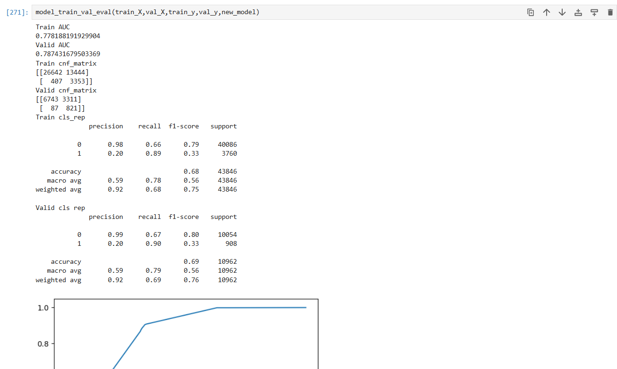

Slide 18
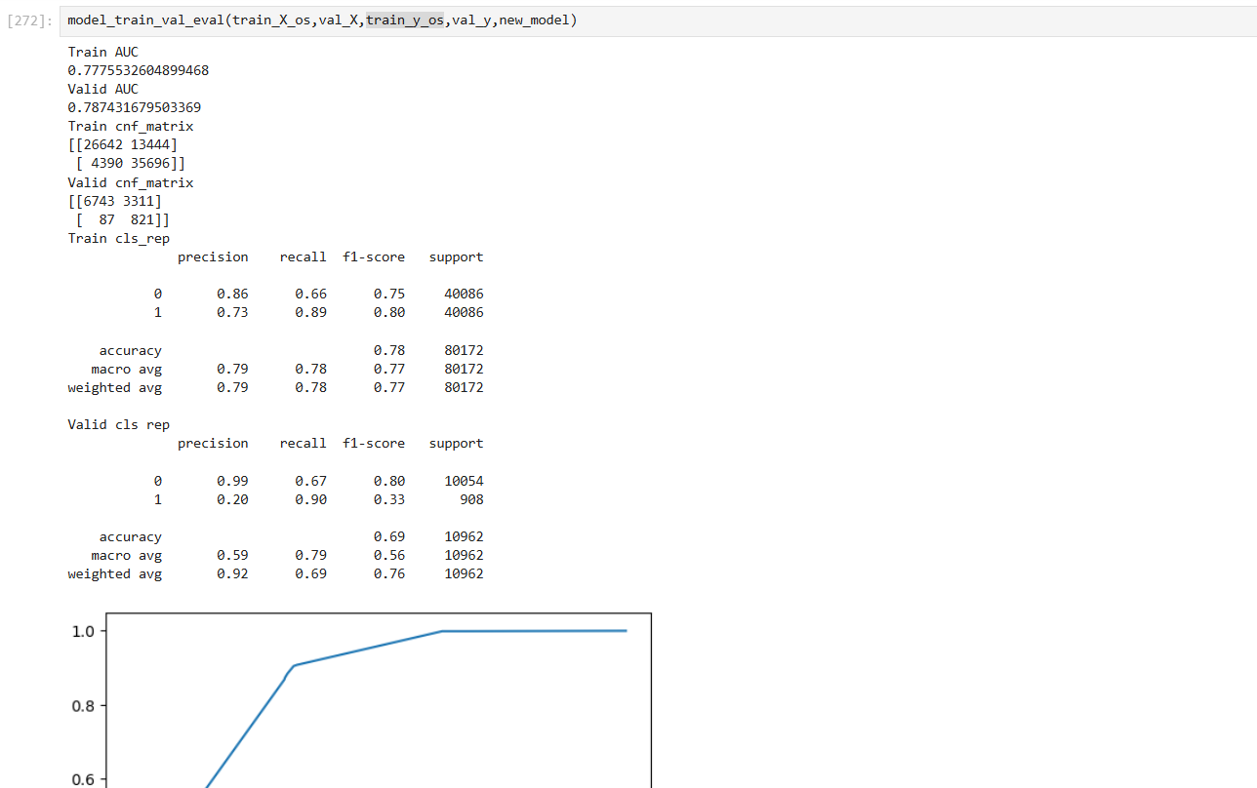
Inserted oversampled data and evaluated the model

Slide 19
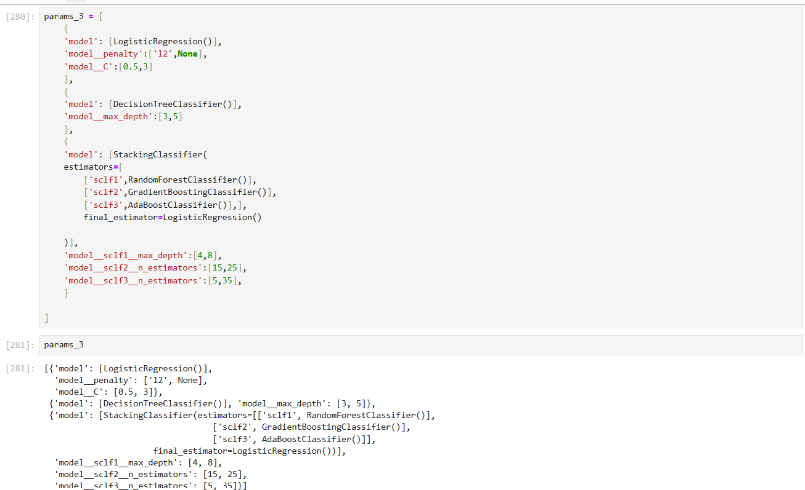
Tried Param grid with RandomForestClassifier, GradientBoostingClassifier,AdaBoostClassifier, StackingClassifier

Slide 20
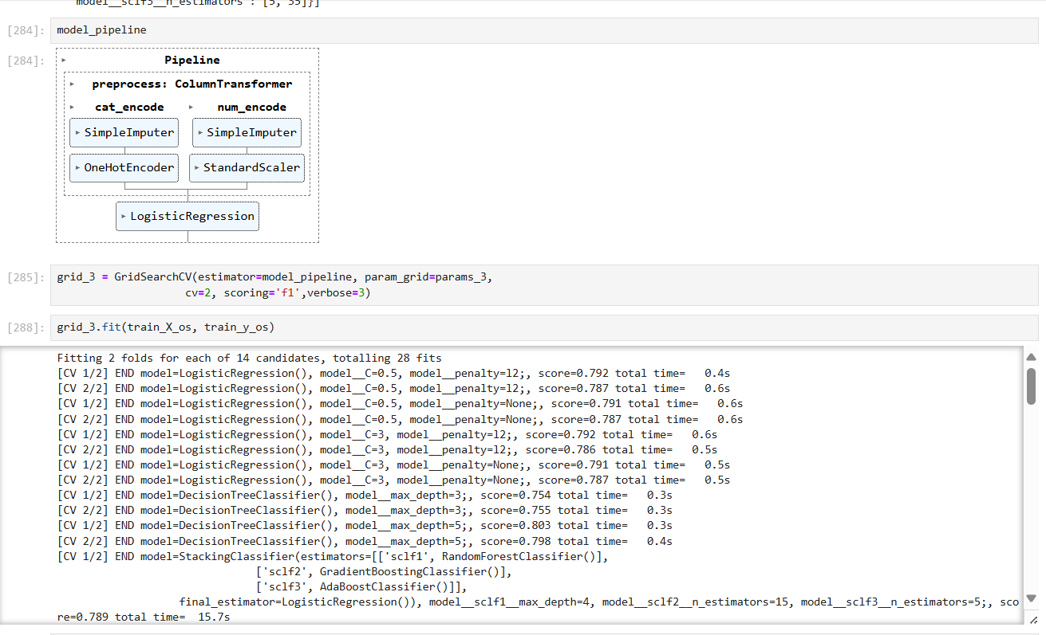
Tried to fit the oversampled data to check the F1 score

Slide 21
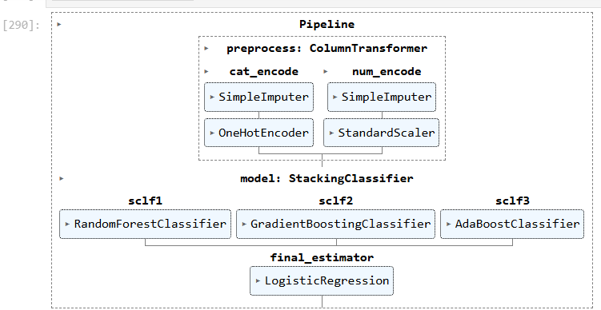
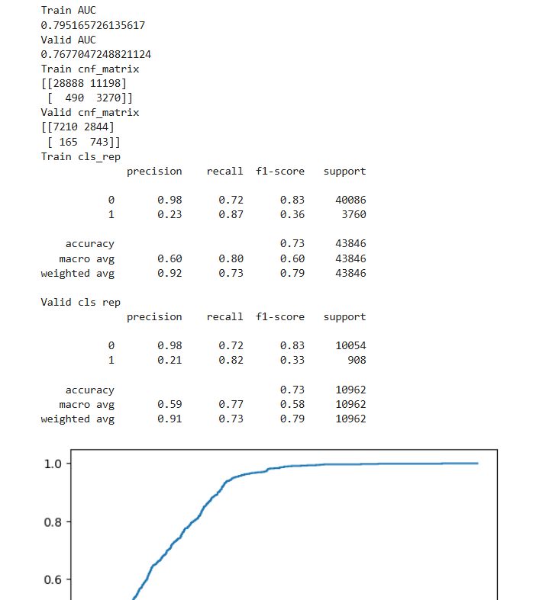
Not much increase in F1 score

Slide 22
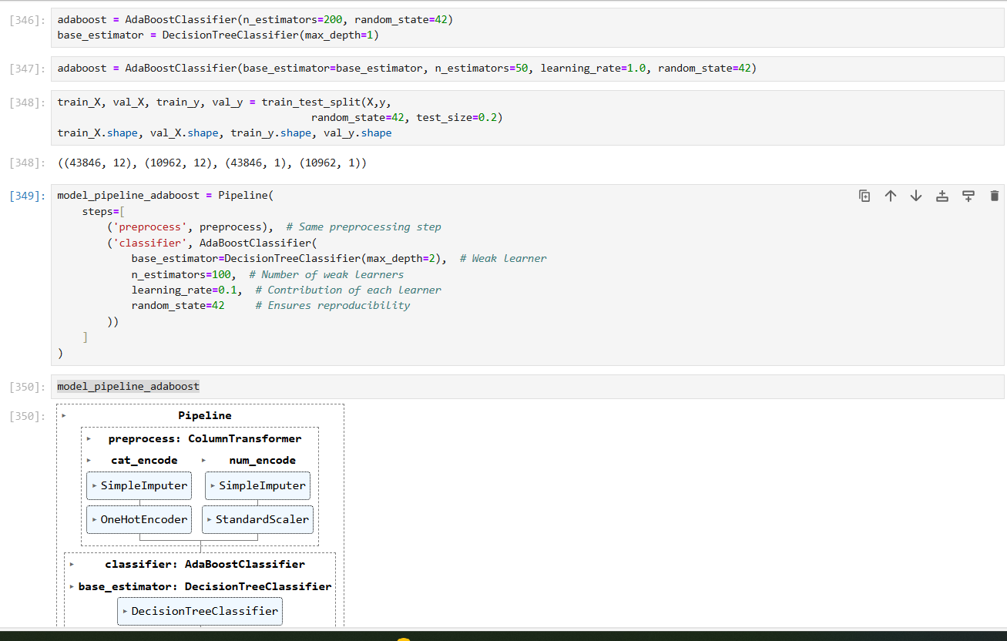
Creating Adaboost pipeline model

Slide 23
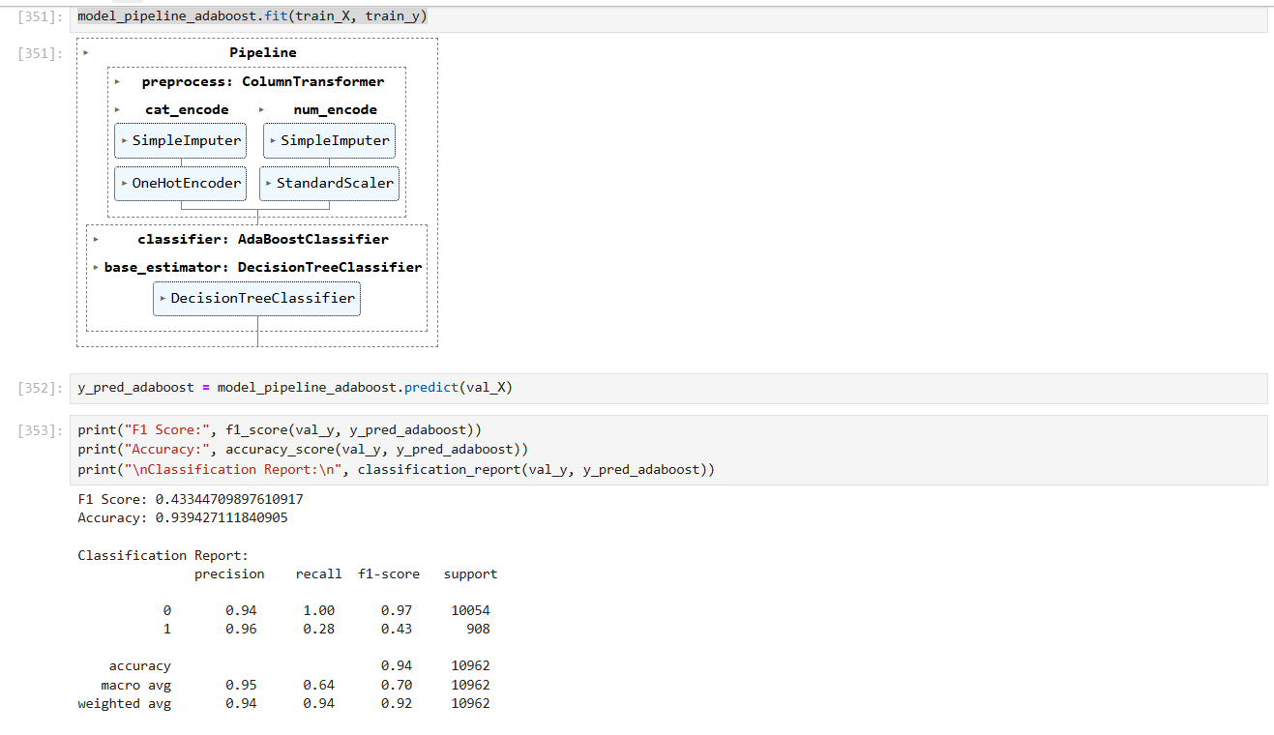

Slide 24
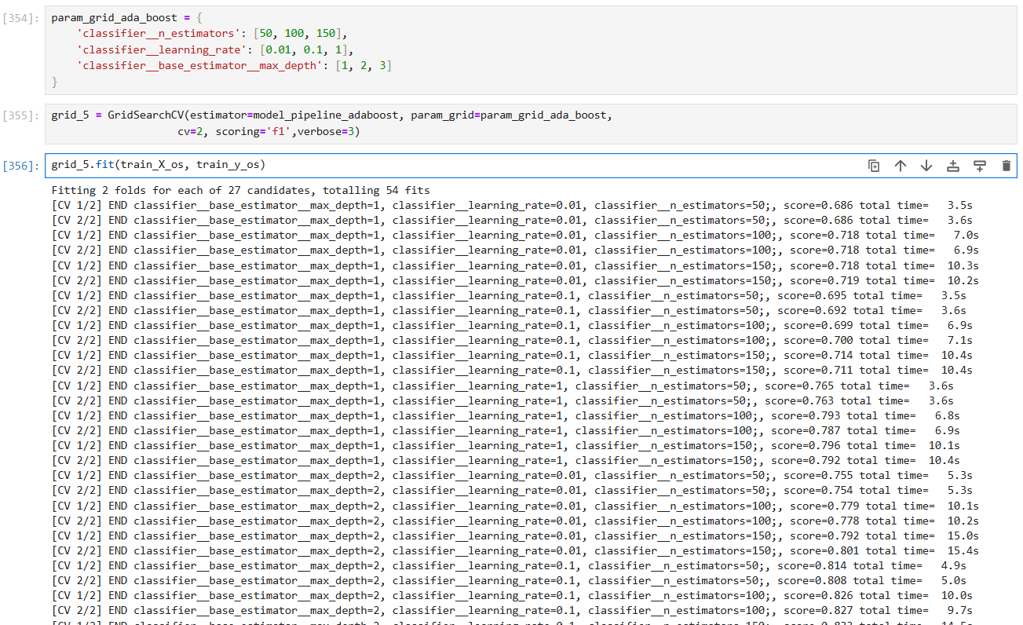

Slide 25
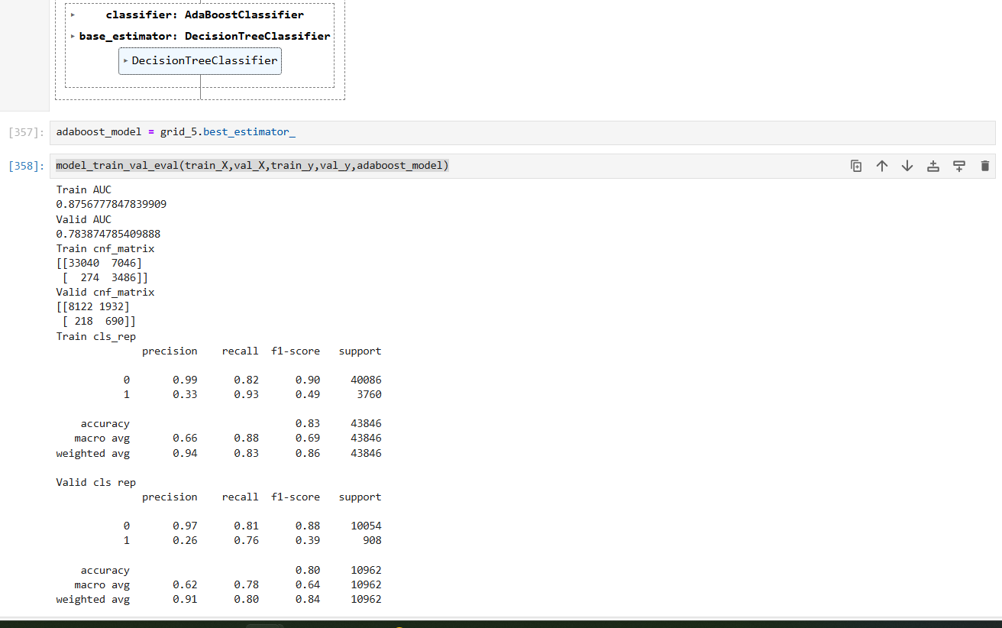
Ada boost report

Slide 26
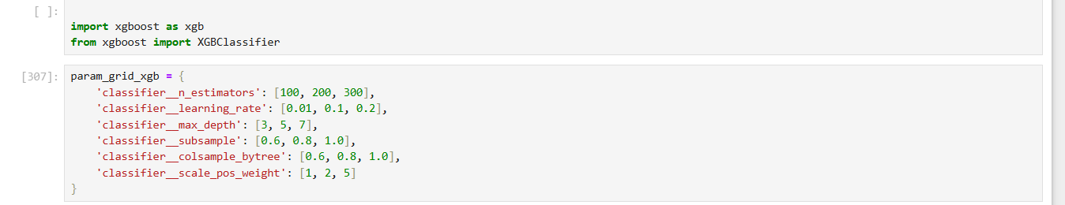
Trying xgboost classifier to increase the F1 score

Slide 27
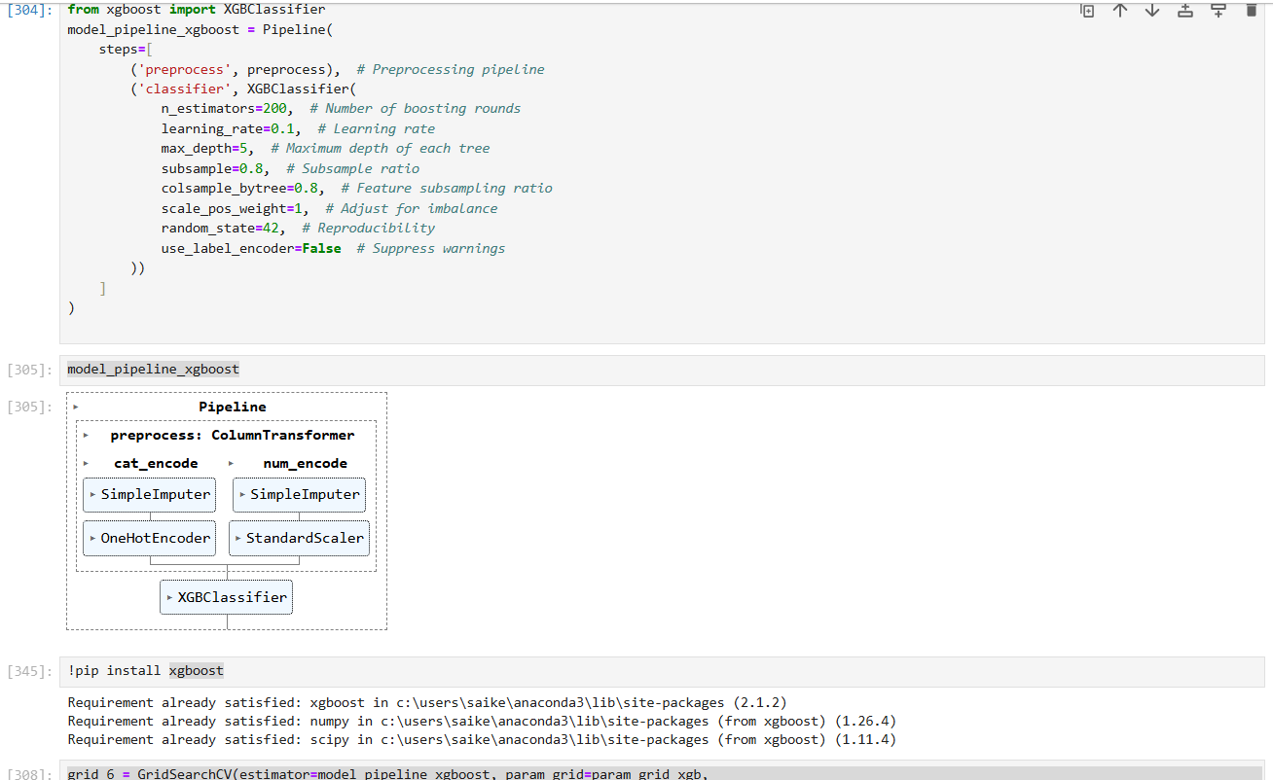

Slide 28
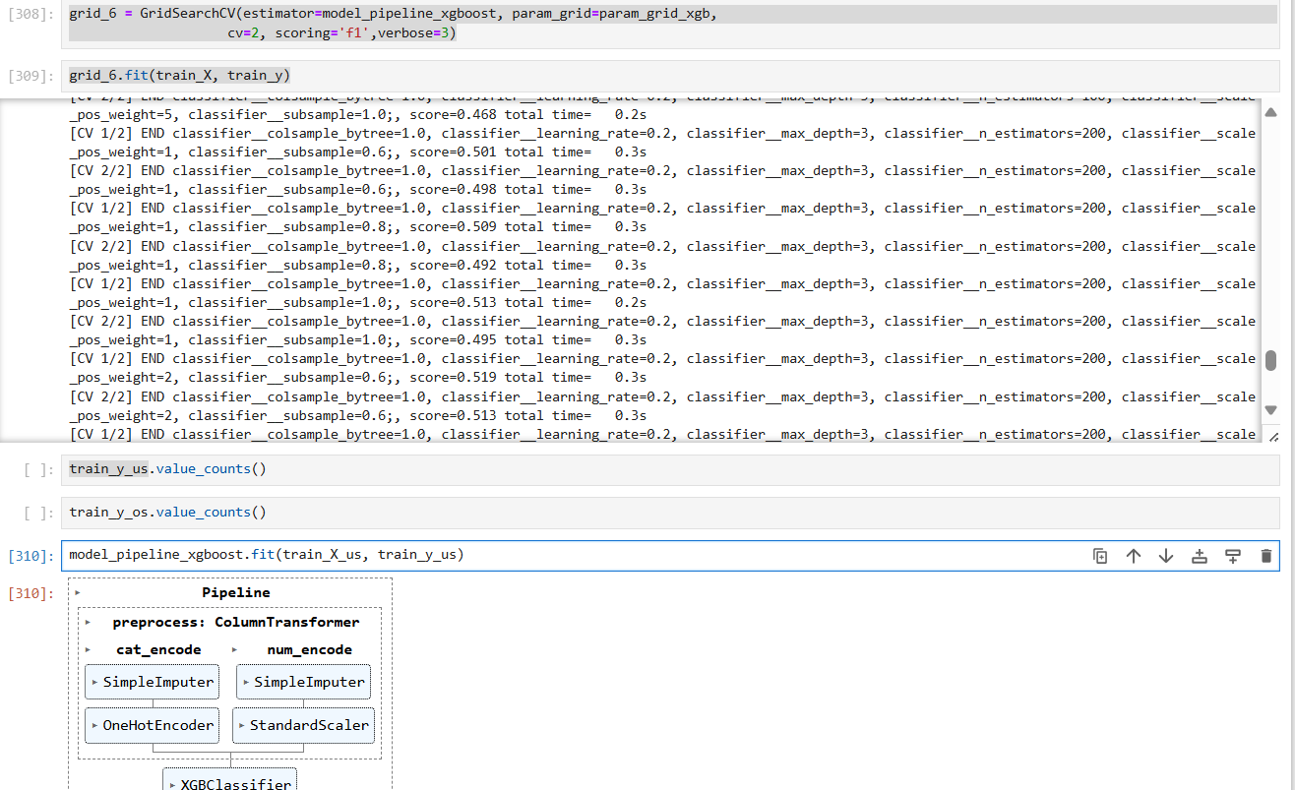
Using Under sampled data in xgboost classifier

Slide 29
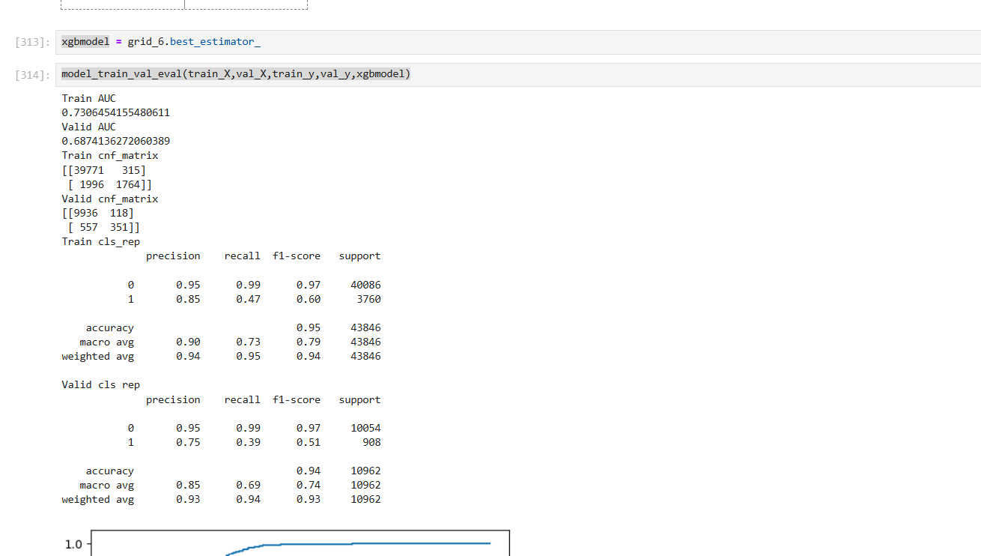
Saw a significant rise in F1 score

Slide 30
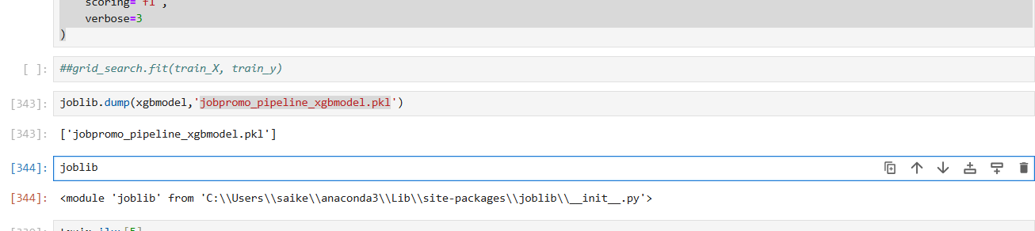
Created pickle file and submitted csv file in Analytics vidya

Slide 31
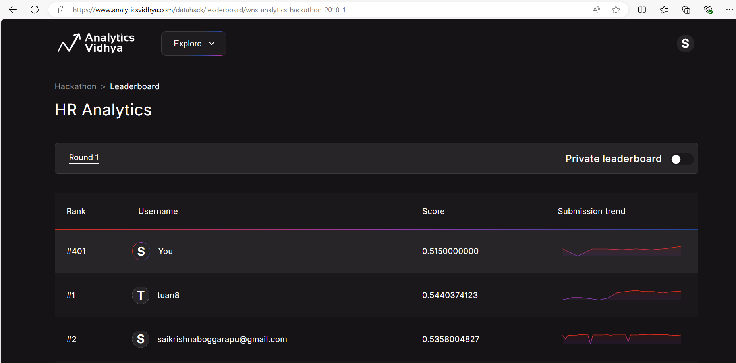
Rank 401

Slide 32
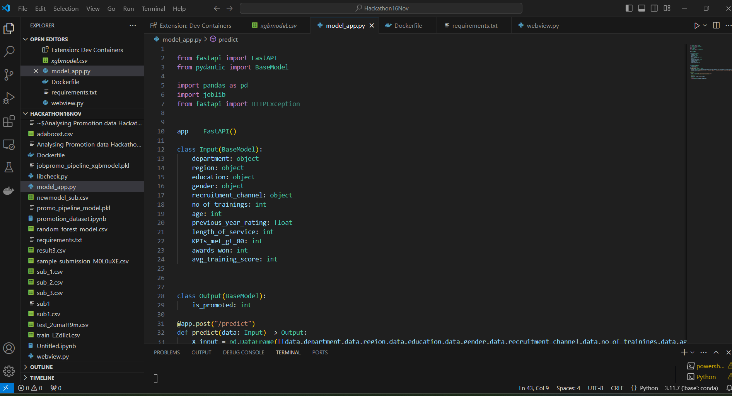
Using FAST API ran the pickle file

Slide 33
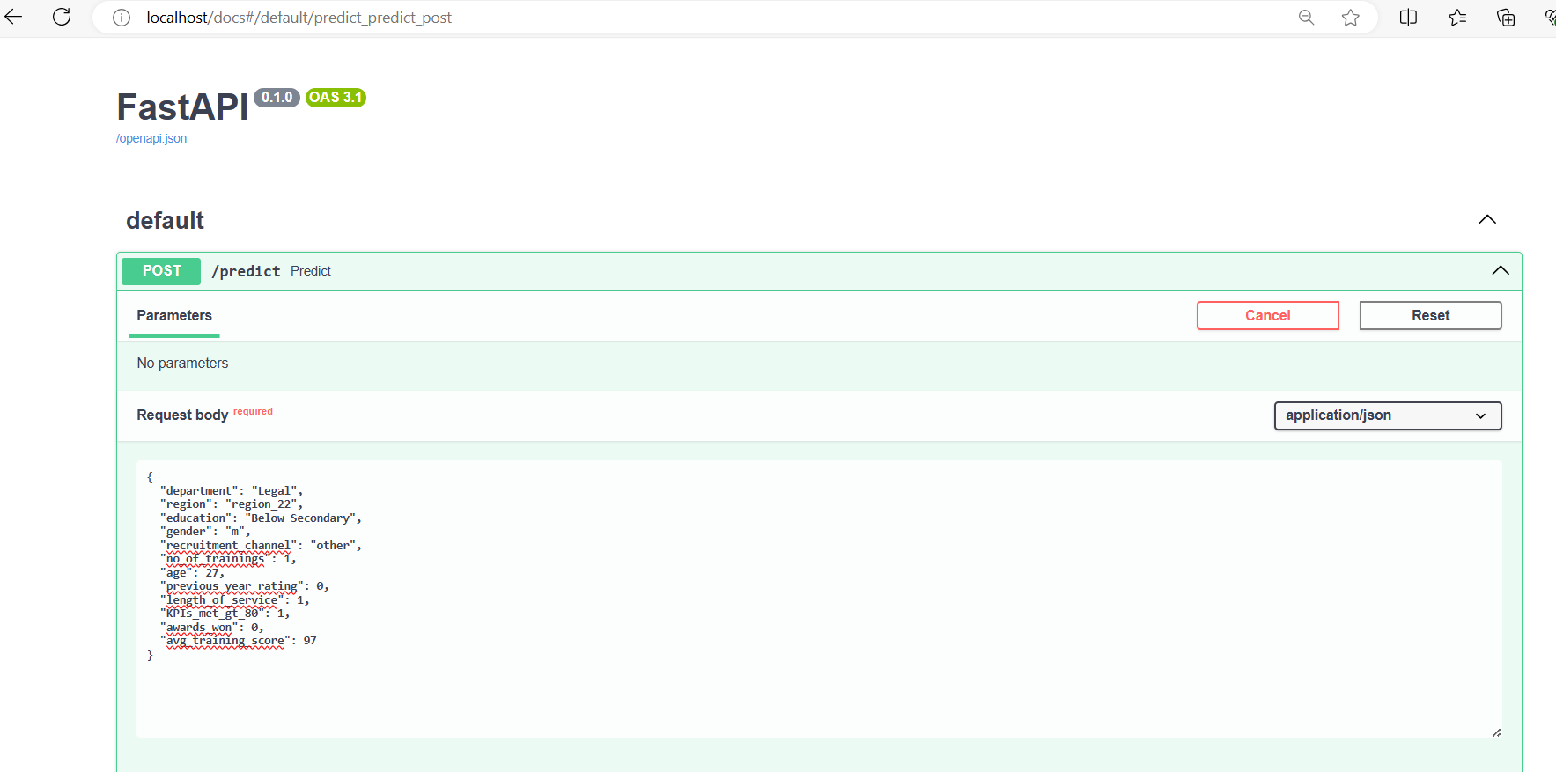
uvicorn model_app:app –reload
FAST API URL Link: FastAPI - Swagger UI

Slide 34
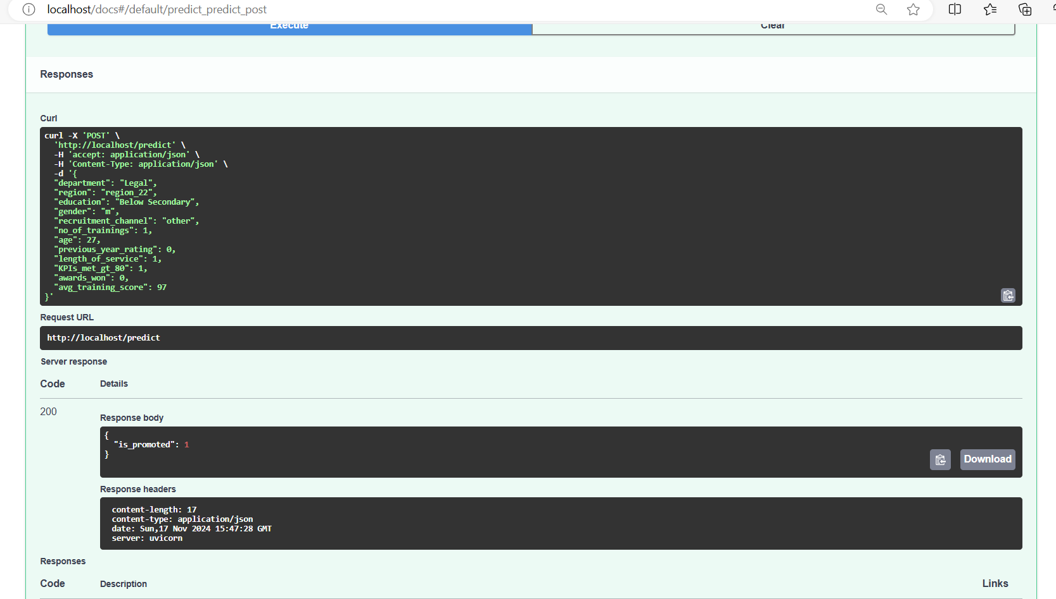

Slide 35
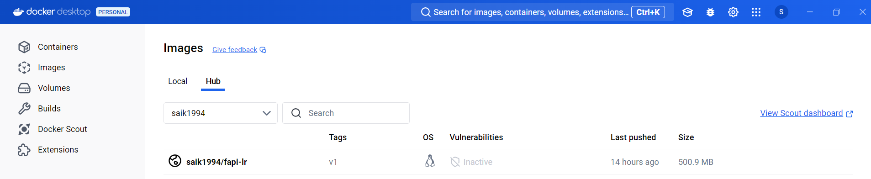
Created Docker file and pushed the files to docker hub
docker login
docker build -t fapi-lr:v1 .
docker tag fapi-lr:v1 saik1994/fapi-lr:v1
docker run -p 80:80 fapi-lr:v1
docker push saik1994/fapi-lr:v1

Slide 36
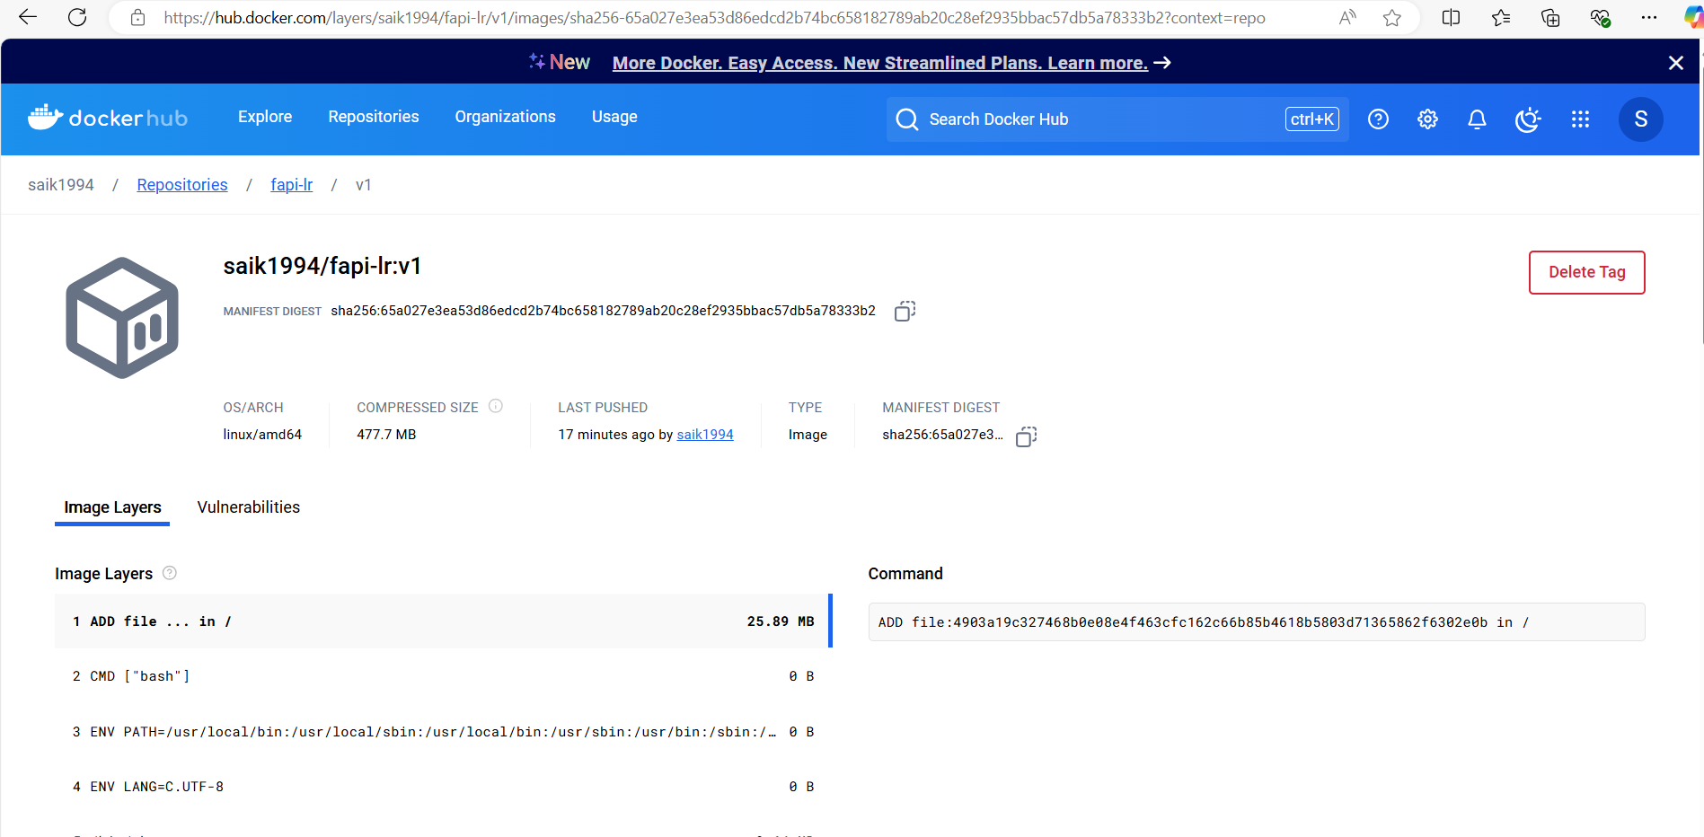
Docker link: Image Layer Details - saik1994/fapi-lr:v1 | Docker Hub

Slide 37
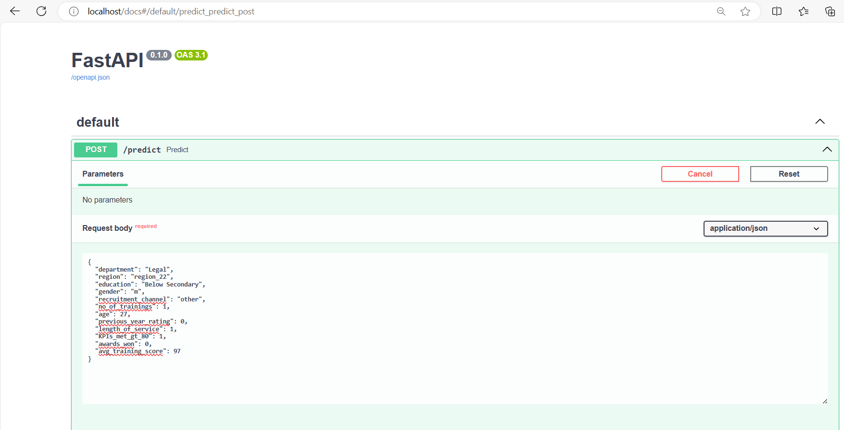
Checking FAST API link generated by docker in local
Link : FastAPI - Swagger UI

Slide 38
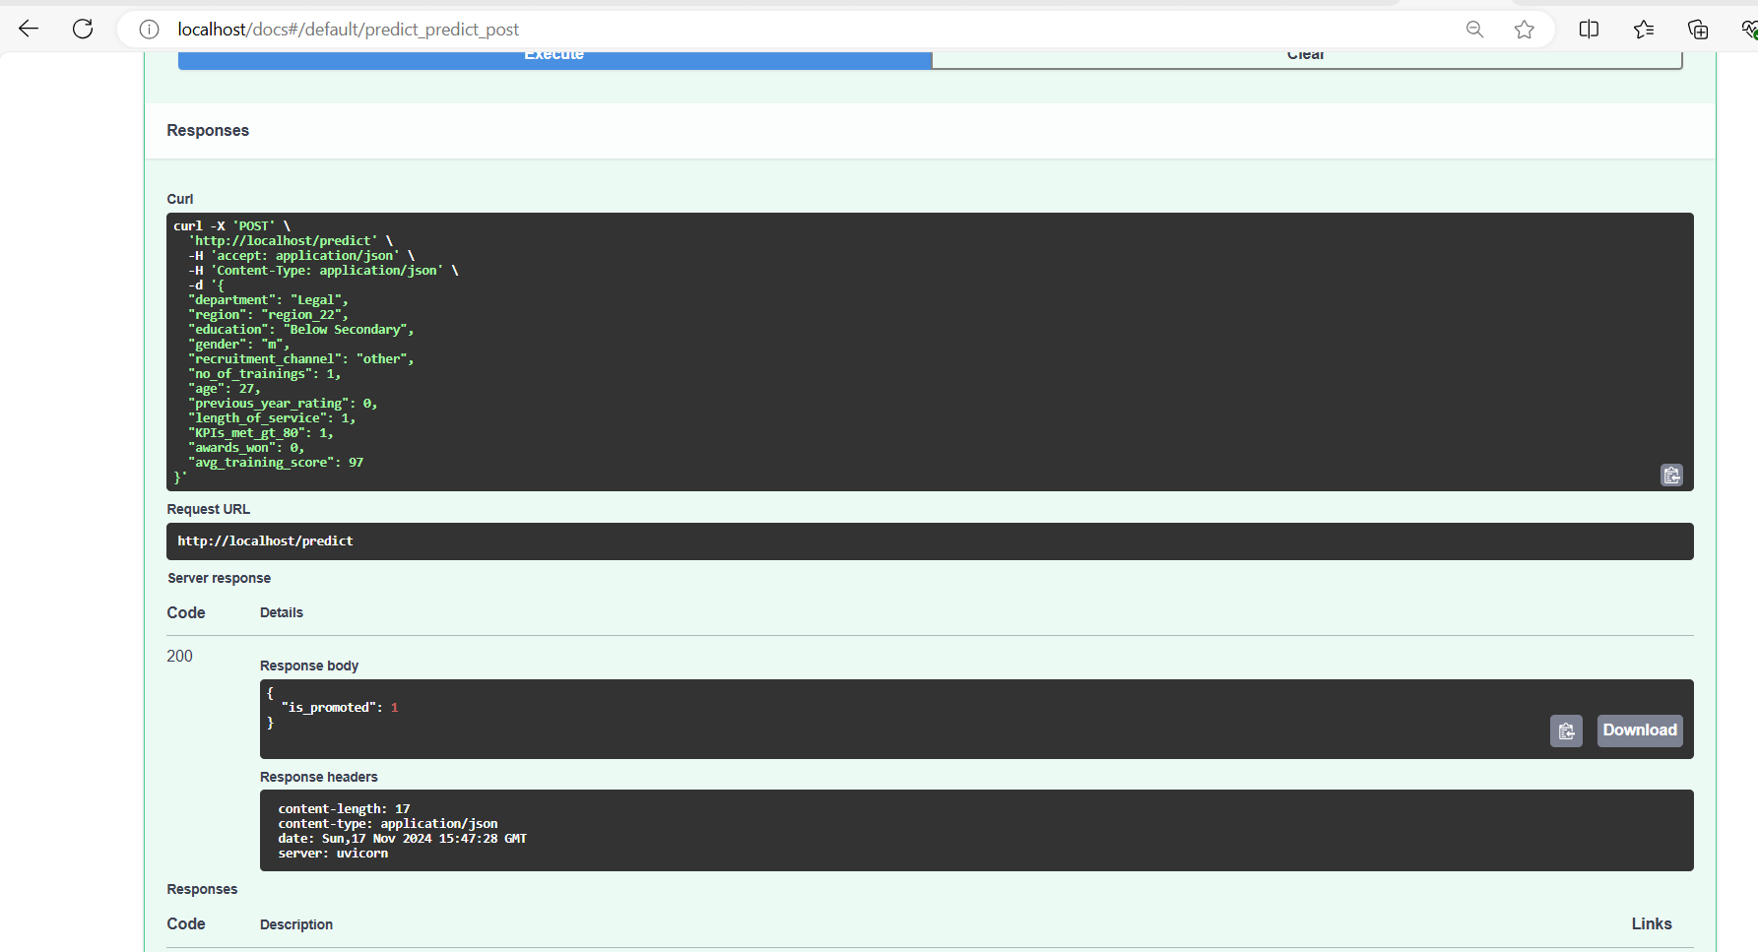

Slide 39
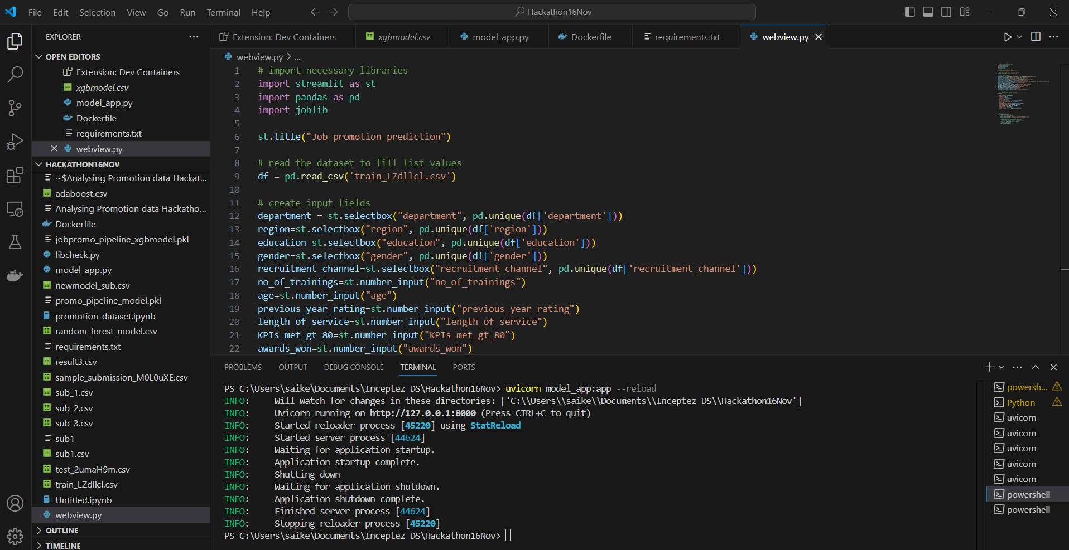
Creating Webview.py

Slide 40
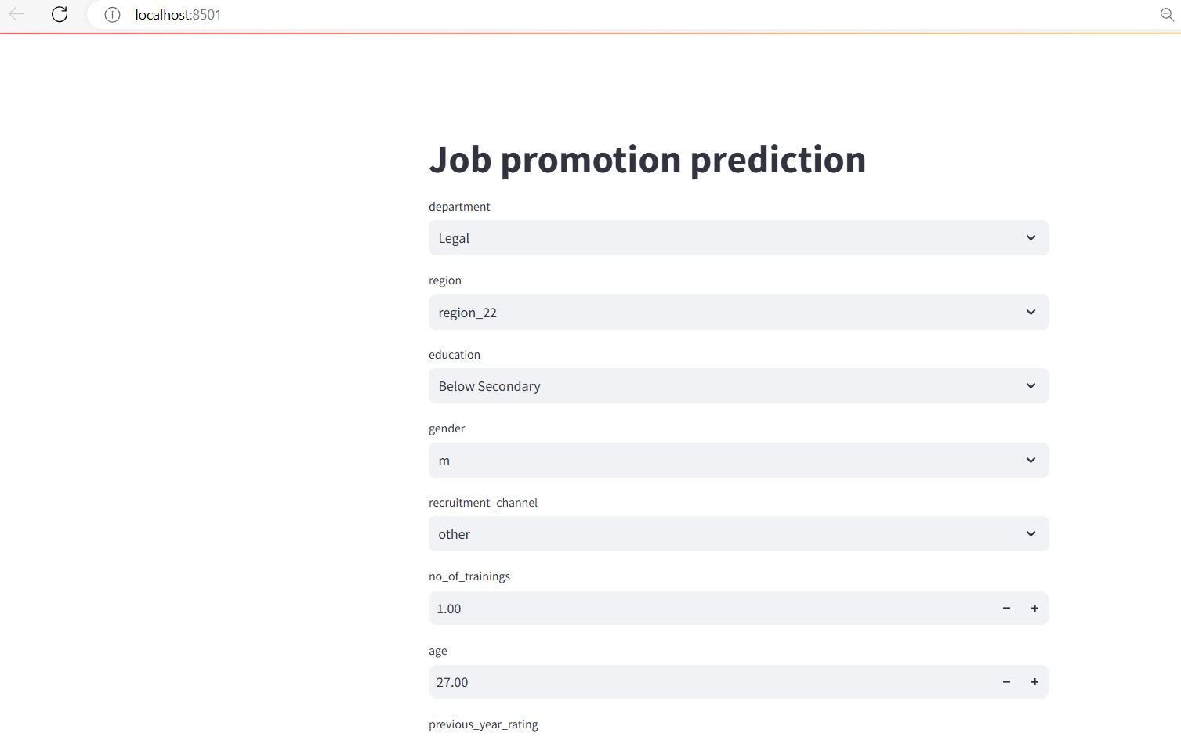
streamlit run webview.py Link: webview

Slide 41
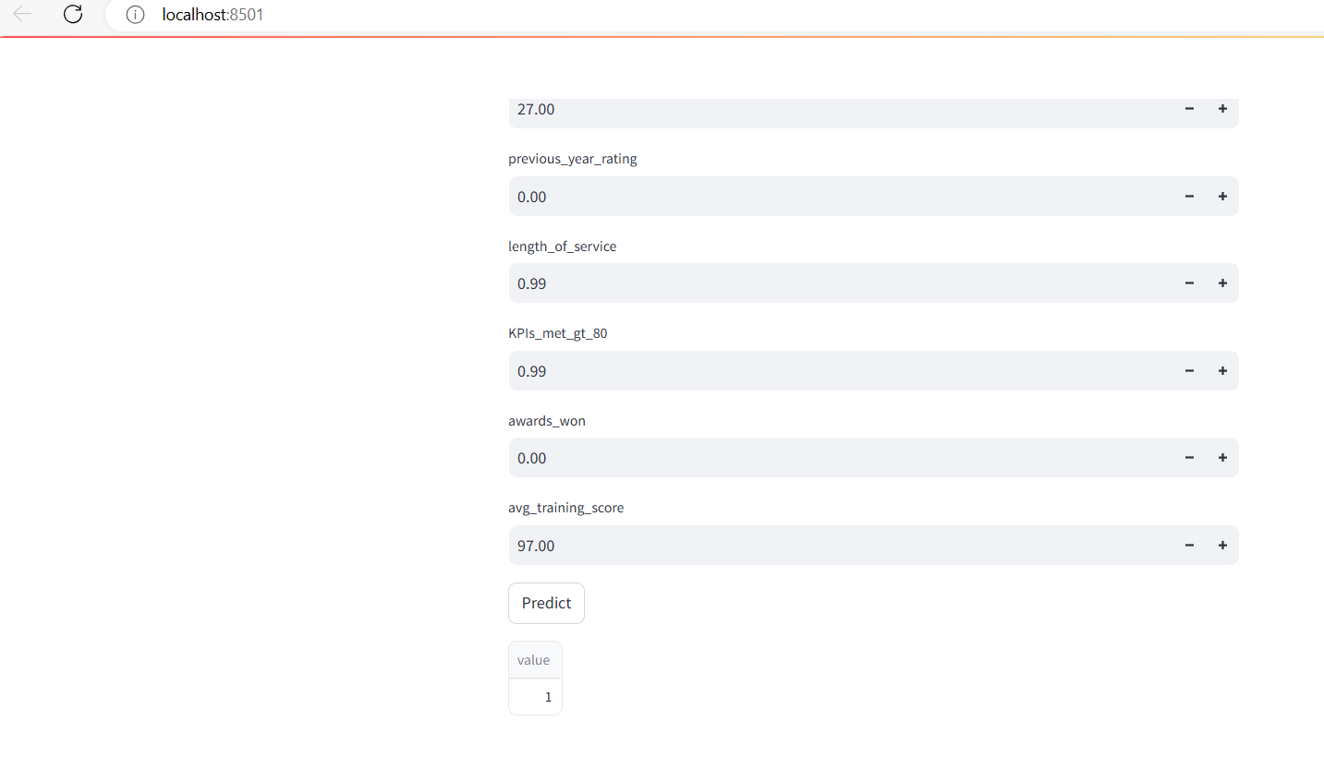

Slide 42
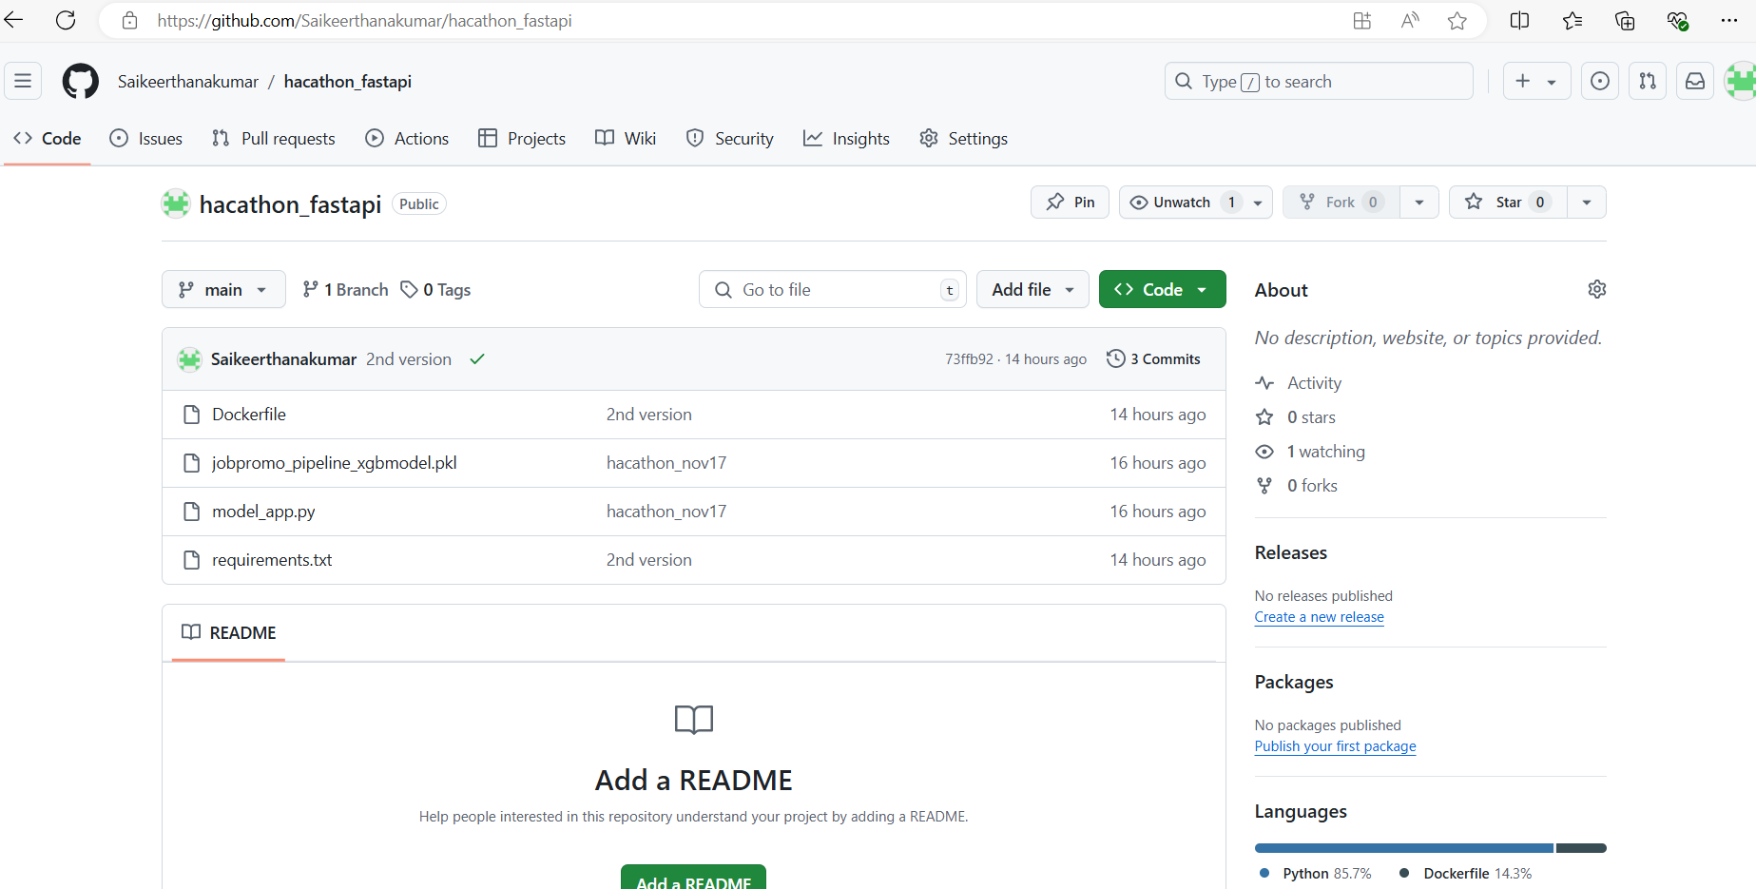
Pushing all the required files into Git hub
Git hub link for fastapi - Saikeerthanakumar/hacathon_fastapi

Slide 43
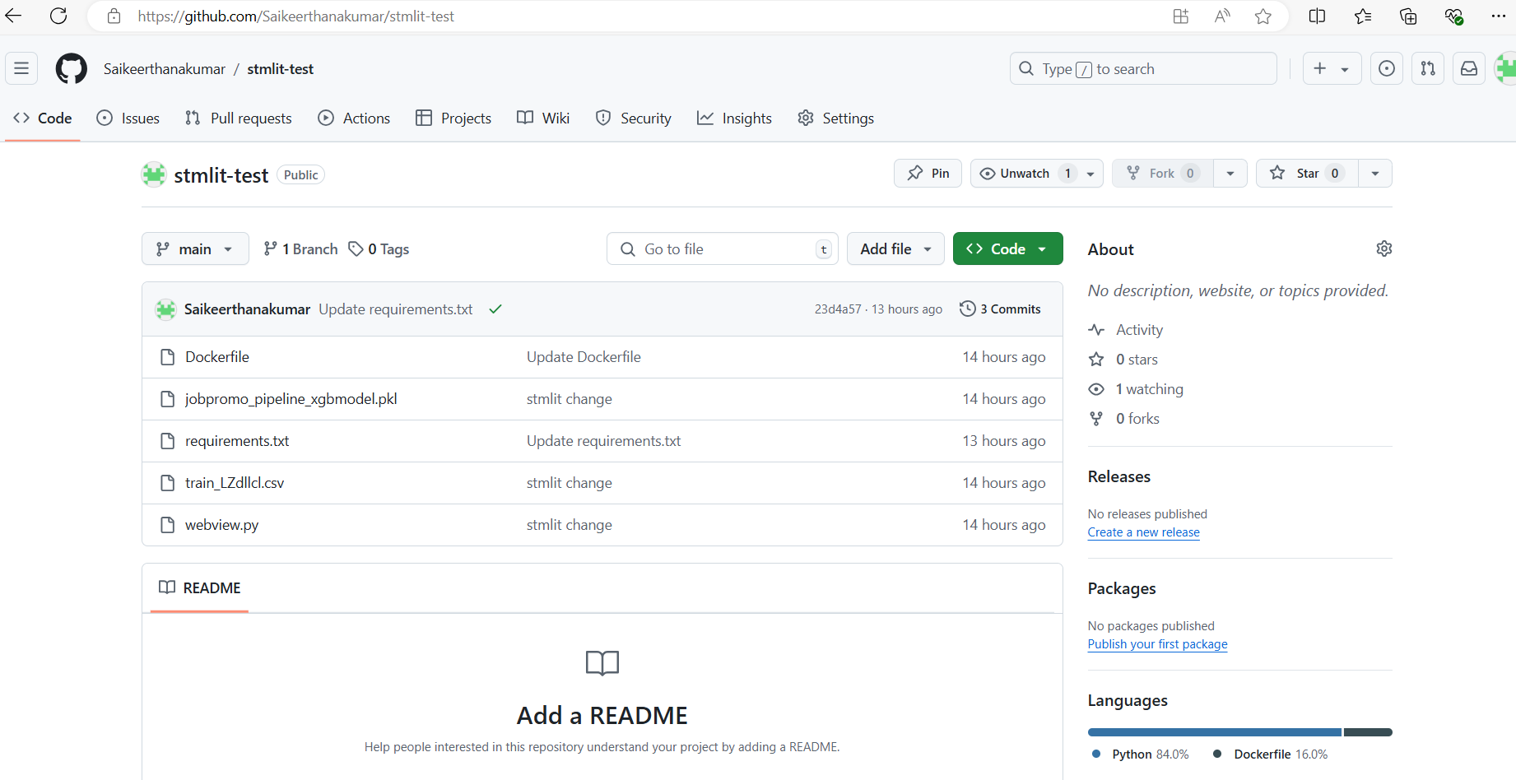
Pushing steamlit to git hub, Link : Saikeerthanakumar/stmlit-test

Slide 44
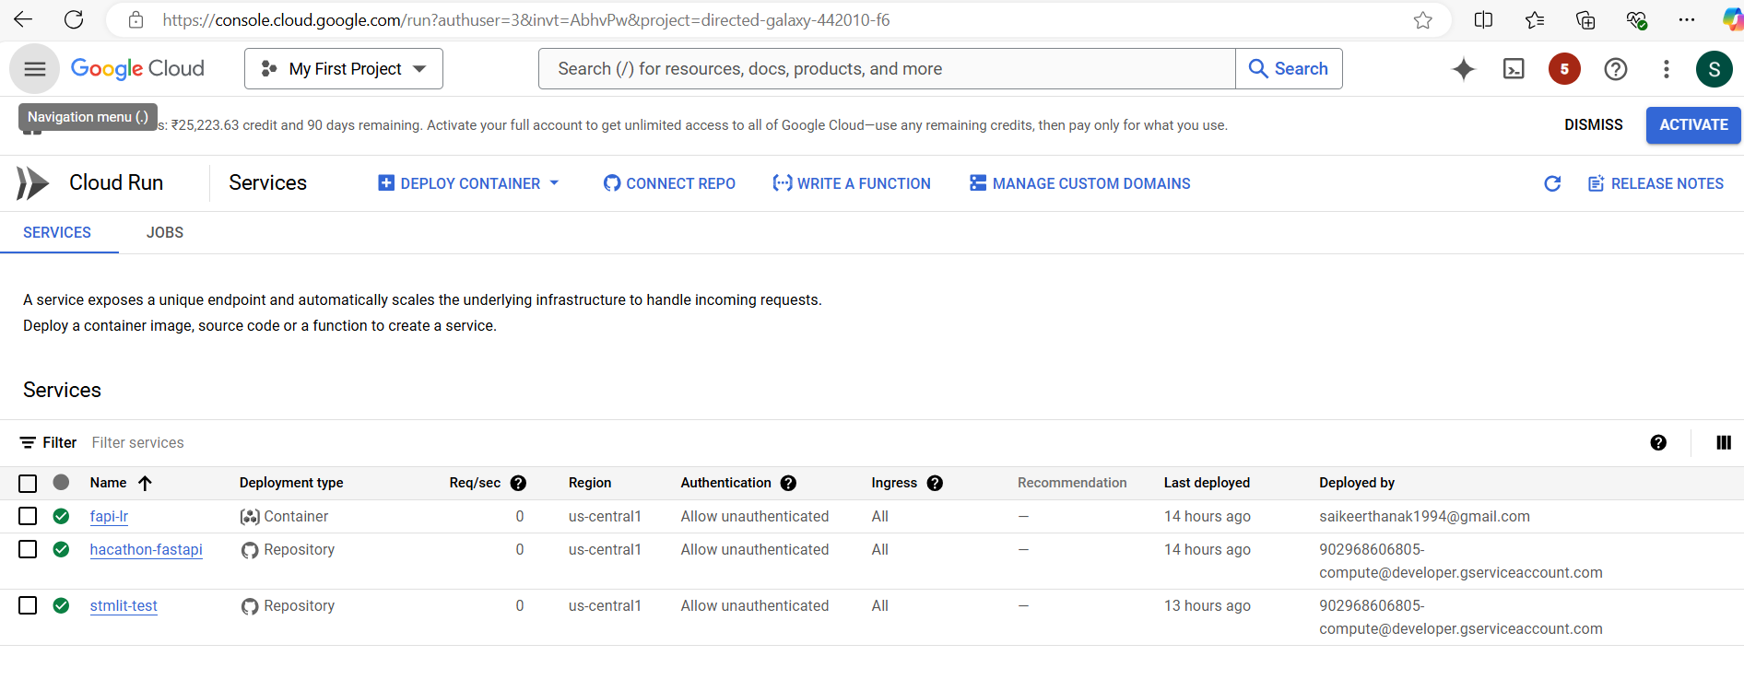
Deploying docker image, git hub – fast api, git hub Streamlit in GCP,
Link: Metrics – …mlit-test – Services – Cloud Run – My First Project – Google Cloud console

Slide 45
URLS:
FAST API:
fast-api_gcp-url
Docker gcp: https://hacathon-fastapi-902968606805.us-central1.run.app
Streamlit gcp: https://stmlit-test-902968606805.us-central1.run.app

Slide 46
After deployment Validated the webview, fastapi – working fine

